Slide 1
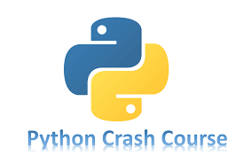

Slide 2
Chapter 2
VARIABLES AND SIMPLE DATA TYPES
Brief Summary of Chapter 2
Chapter 2 introduces basic programming concepts in Python, focusing on variables and simple data types. It explains how to assign values to variables, the importance of good variable names, and how Python stores data. The chapter also covers common data types such as strings, integers, and floats, and introduces string manipulation methods like changing case and formatting with f-strings. Additionally, it discusses whitespace handling, including how to add tabs, newlines, and strip unnecessary spaces. The chapter highlights the importance of writing clear, concise comments to enhance code readability and maintainability.

Slide 3
Variables
Variables are essential in programming because they store data that can be used and manipulated throughout a program. Think of a variable as a label that holds a value, such as a number, string, or other data types. Instead of repeating values in your code, you can use variables to reference them, making your code cleaner, more flexible, and easier to maintain.
Naming variables correctly is important for making your code easy to understand. Use clear names like age or score and avoid using Python keywords (e.g., if, for, while). Variable names must start with a letter or an underscore, but they can’t start with a number or include spaces or special characters. Additionally, try to keep variable names short but descriptive, such as student_name instead of s_n, and avoid confusing letters like l and O, which can look like 1 and 0.

Slide 4
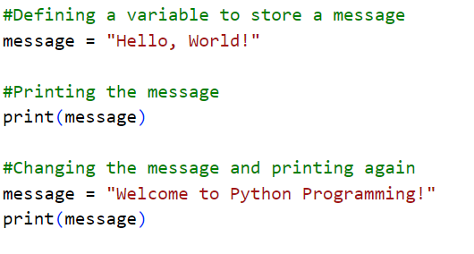

Slide 5
Strings
A string in Python is a sequence of characters, such as letters, numbers, symbols, or spaces, enclosed in either single quotes (' ') or double quotes (" "). Strings are one of the most commonly used data types in programming because they allow you to work with text data.
Strings in Python are immutable, meaning once created, they cannot be changed directly. For example, if you want to modify a string, you must create a new one. However, you can perform operations on strings to manipulate them, such as concatenation (combining strings), repetition (repeating strings), and slicing (extracting portions of a string).

Slide 6
Common String Operations:
Concatenation: Combining two or more strings into one.
Repetition: Repeating a string multiple times.
Slicing: Extracting a portion of a string.
Escape Characters: Special characters like newline (\n) and tab (\t)
String Length: The len() function is used to find the length of a string (number of characters
Indexing and Negative Indexing: Strings are indexed starting from 0 (from the left). Negative indexing allows you to count from the end.
String Comparison: You can compare strings using comparison operators like ==, !=, <, >.

Slide 7
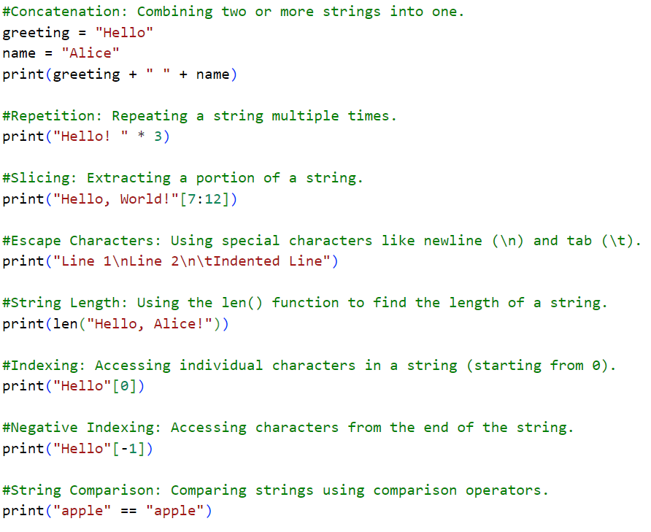

Slide 8
Common String Methods: Python strings come with several useful methods:
upper(): Converts all characters to uppercase.
lower(): Converts all characters to lowercase.
strip(): Removes leading whitespace.
replace(): Replaces one substring with another.
find(): Finds the index of the first occurrence of a substring.
split(): Splits a string into a list, based on a delimiter.

Slide 9
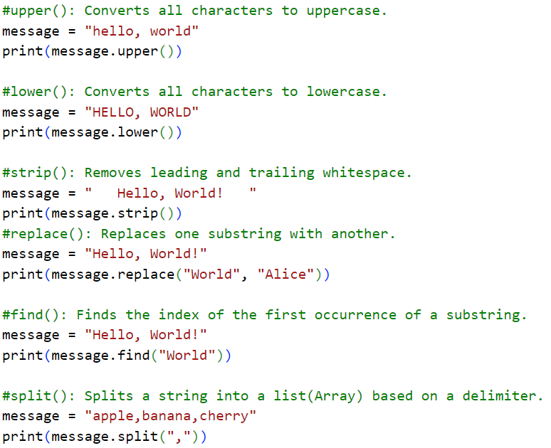

Slide 10
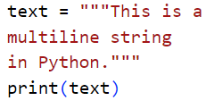

Multiline Strings: You can create strings that span multiple lines by using triple quotes (''' or """). This is useful when you need to include line breaks or write long blocks of text without using escape characters.
Example : Output:

Slide 11
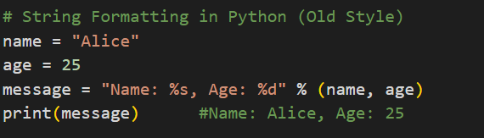
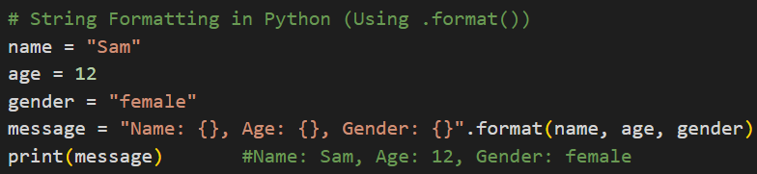
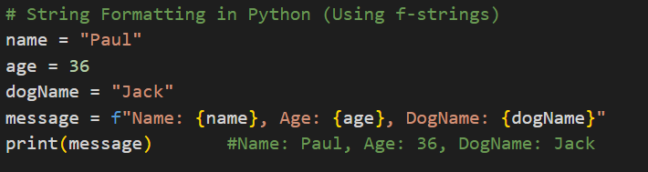
String Formatting: You can insert values into strings using several methods:
Old-style formatting (%): Uses placeholders like %s for string and %d for decimal number
str.format() method: More flexible, using curly braces {} as placeholders.
f-strings (Python 3.6+): The most modern and readable approach, using {} with variables directly inside the string prefixed by f.

Slide 12
Numbers
Numbers in programming are essential for calculations, storing information, and making decisions. In Python, there are two main types of numbers: Integers and Floats.
Integers: Whole numbers (positive, negative, or zero) used in basic math operations.
Floats: Numbers with decimal points.
Operations: Python supports addition, subtraction, multiplication, division, and exponentiation for both integers and floats. Integer division always results in a float.
Formatting with Underscores: Large numbers can include underscores (e.g., 1_000_000) to make them easier to read without changing their value.
Multiple Assignment: Python allows assigning values to multiple variables in one line,by using a comma which makes the code cleaner
Constants: Python doesn’t have built-in constants, but programmers use uppercase variable names (e.g., MAX_CONNECTIONS = 5000) to indicate values that should not change.

Slide 13
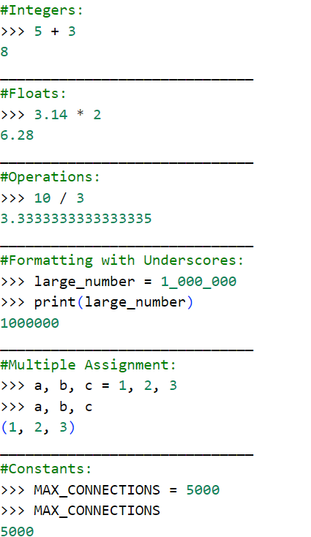
In the command line (or REPL), Python automatically shows the result when you type expressions or variables, so you don’t need to use print(). For example, if you type a, b, c, Python will immediately display their values.
In a script, however, Python doesn't show any output unless you explicitly use print(). So, when working with variables like large_number, you must use print(large_number) to display its value.
In this case, since we are using the shell, we don’t need to use print(large_number) because Python would automatically display the result. However, we use print() anyway because it’s good practice, especially if you want to ensure the output is shown clearly.

Slide 14

Comments
A comment is a note in your code that helps explain what the code is doing. It doesn’t affect how the program runs. In Python, comments start with the #symbol.
The Zen of Python
The Zen of Python is a set of simple rules for writing clean and easy-to-understand code. It encourages you to write code that is straightforward and not complicated.
More about Zen of Python: https://www.datacamp.com/blog/lessons-from-the-zen-of-python

Slide 15
Practice exercises
Do the follow TRY IT YOURSELF on pages:
19
25
29
30
31

Slide 16

End
Of
Chapter 2

